Slide 1
Memory Organization

Slide 2
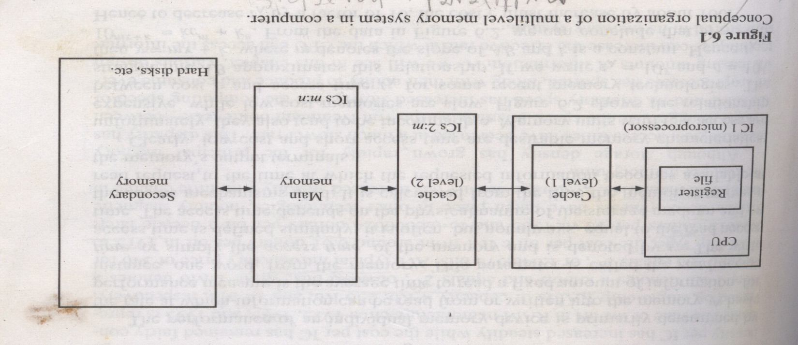
Goal of memory system:
To provide adequate storage capacity with an acceptable level of performance and cost.
i.e. high average performance at low average cost.

Slide 3
Memory Types
CPU Register | Main Memory | Secondary Memory | Cache
working memory for temporary storage of instr and data | External memory for storing active programs and data. | Non-volatile memory for storing system programs, large data files . | Used for caching frequently used data.
Speed: very high | Speed: slower compared to register | Speed: slower than main memory | Speed:Faster than main memory
Capacity: 32 data words | Capacity: many Gigabytes | Capacity: many Gigabytes | Capacity:
Access time : single clock cycle | Access time : Five or more cycles | Access time : Measured in milliseconds | Access time : 1 to 3 clock cycle

Slide 4
Performance and cost
Cost
c = C/S dollars per bit
Performance:
determined by rate of information read from or written to memory.
basic performance measure is average access time of the memory
Read access time(tA): average time to read a fixed amount of information from memory.

Slide 5
Performance and cost
Access time is calculated from the time memory receives a read request to the time at which the requested information becomes available at memory output terminal

Slide 6
Types of Memory
There are two kinds of main memory: random access memory, RAM, and read-only-memory, ROM.
There are two types of RAM, dynamic RAM (DRAM) and static RAM (SRAM).
Dynamic RAM consists of capacitors that slowly leak their charge over time. Thus they must be refreshed every few milliseconds to prevent data loss.
DRAM is “cheap” memory owing to its simple design.
SRAM consists of circuits similar to the D flip-flop
SRAM is very fast memory and it doesn’t need to be refreshed like DRAM does. It is used to build cache memory
ROM also does not need to be refreshed, either. In fact, it needs very little charge to retain its memory.
ROM is used to store permanent, or semi-permanent data that persists even while the system is turned off.

Slide 7
The Memory Hierarchy
Faster memory is more expensive than slower memory.
For the best performance at the lowest cost, memory is organized in a hierarchical fashion.
Small, fast storage elements are kept in the CPU, larger, slower main memory is accessed through the data bus.
Larger, (almost) permanent storage in the form of disk and tape drives is still further from the CPU.
Processor
Control
Tertiary
Storage
(Tape)
Secondary
Storage
(Disk)
Third
Level
Cache
(SRAM)
Main
Memory
(DRAM)
Second
Level
Cache
(SRAM)
Datapath
On-Chip
Cache
Registers

Slide 8
The Memory Hierarchy
Component | Access Speed (Time for data to be returned) | Size of Component
Registers | 1 cycle = 0.3 nanoseconds | 8 registers
L1 Cache | 3 cycles = 1 nanoseconds | Separate Data and Instruction Caches: 16 Kbytes each
L2 Cache | 20 cycles = 7 nanoseconds | 256 Kbytes, 8-way set associative
L3 Cache | 40 cycles = 13 nanoseconds | 4096 Kbytes, 8-way set associative
Memory | 300 cycles = 100 nanoseconds | 16 Gigabytes
Disk | 30,000,000 cycles = 10 milliseconds | 400 Gigabytes
Notes:
The design goal is to present the user with as much memory as is available in the cheapest technology (points to the disk).
While by taking advantage of the principle of locality, we like to provide the user an average access speed that is very close to the speed that is offered by the fastest technology.
(We will go over this slide in details in the next lecture on caches).
+1 = 16 min. (X:56)

Slide 9
How Is the Hierarchy Managed?
The Memory Hierarchy
Access Registers or Memory
By compiler (programmer?)
Access Cache or Memory
By the hardware
Access Memory or Disks
By the hardware and operating system (virtual memory)
By the programmer (files)

Slide 10
The Memory Hierarchy
Mechanism:
To access a particular piece of data, the CPU sends a request to its nearest memory, usually cache.
If the data is not in cache, then main memory is queried. If the data is not in main memory, then the request goes to disk.
Once the data is located, the data, and nearby data elements are fetched into cache memory.
“Lower Level”
Memory
To Processor
“Upper Level”
Memory
Blk X
From Processor
Blk Y

Slide 11
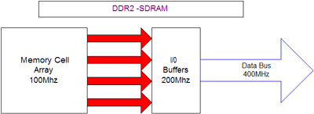
Random Access Memory
The Memory Hierarchy
SDRAM;
Short for Synchronous DRAM, a type of DRAM that can run at much higher clock speeds than conventional memory. SDRAM actually synchronizes itself with the CPU's bus and is capable of running at 133 MHz,
DDR (Double Data Rate) is a technology used in some SDRAM memories to increase the speed at which data can be written/retrieved from the memory.
DDR increase the transfer rate by sending/receiving memory data twice per clock cycle. This give a theoretical multiplication of transfer speed by two.
DDR2-SDRAM maintains the same core functions, transferring 64 bits of data twice every clock cycle for an effective transfer rate twice that of the front-side bus (FSB) of a computer system, and an effective bandwidth equal to its speed x 8.
Notes:
By now, you are probably wondering: Gee, I want to be a computer designer, why do I have to worry about RAM technology?
Well, the reason you need to know about RAM is that most modern computers’ performance is limited by memory bandwidth.
So if you know how to make the most out of the RAM technology available, you will end up designing a faster computer.
Also, if you are going to design a microprocessor, you will be able to put a lot of memory on your chip so you need to know the RAM technology in order to tailor the on-chip memory for your specific needs.
So the bottom line is that better you know about the RAM technology, better a computer designer you will become.
What makes RAM different from a bunch of flip flops?
The main difference is density. For the same area, you can have much more bits of RAM than you can have flip flops.
+2 = 26 min. (Y:06)

Slide 12
Cache Memory
The purpose of cache memory is to speed up accesses by storing recently used data closer to the CPU, instead of storing it in main memory.
Although cache is much smaller than main memory, its access time is a fraction of that of main memory.
Unlike main memory, which is accessed by address, cache is typically accessed by content; hence, it is often called content addressable memory.
Because of this, a single large cache memory isn’t always desirable-- it takes longer to search.

Slide 13
Cache Memory
The “content” that is addressed in content addressable cache memory is a subset of the bits of a main memory address called a field.
The fields into which a memory address is divided provide a many-to-one mapping between larger main memory and the smaller cache memory.
Many blocks of main memory map to a single block of cache. A tag field in the cache block distinguishes one cached memory block from another.

Slide 14
Access Modes
Access mode specifies the order or sequence in which the information is accessed.
Access modes:
Random access memory
Serial access memory

Slide 15
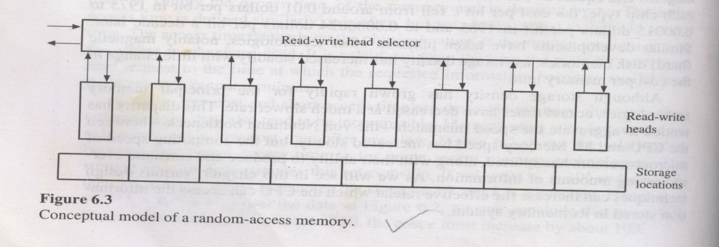
Access Modes
Random access memory
storage locations accessed in any order.
access time independent of the location being accessed
each location has separate access mechanism.

Slide 16
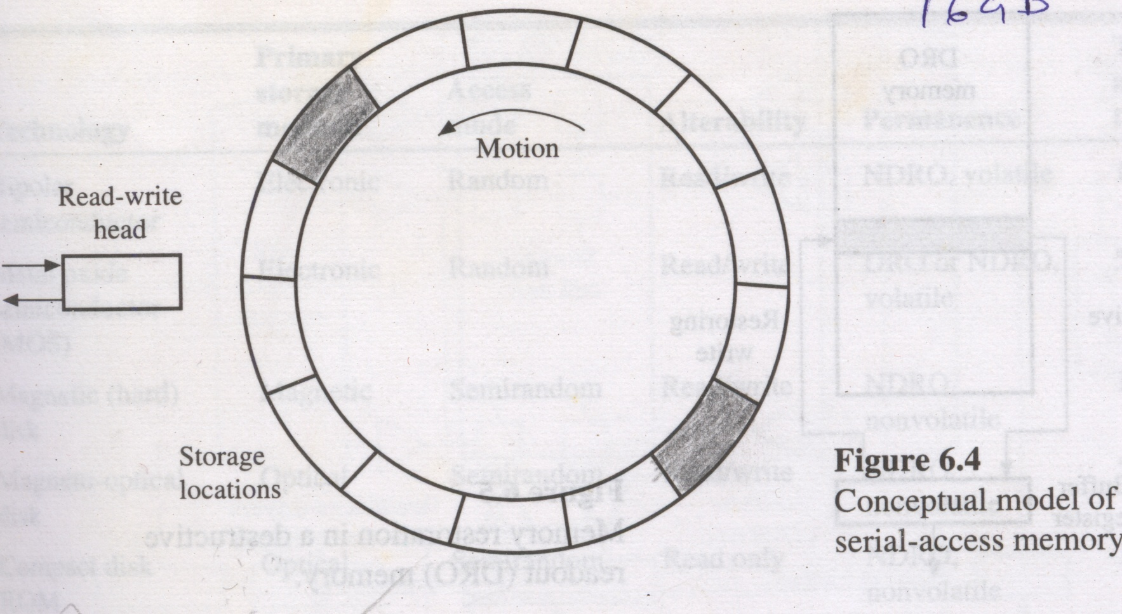
Access Modes
Serial access memory
storage locations are accessed serially.
access time is dependent on the location being accessed
all locations share the access mechanism.

Slide 17
Access Modes
Semirandom access memory
Storage locations are arranged in multiple tracks.
Tracks are accessed independently using separate read write head for each track.
Tracks are divided into blocks and all the blocks in the track are sharing single read write head so, they are accessed serially.

Slide 18
Disk “Geometry”
Disks contain platters, each with two surfaces
Each surface organized in concentric rings called tracks
Each track consists of sectors separated by gaps
tracks
surface
track k
gaps
spindle
sectors

Slide 19
Disk Structure
Read/Write Head
Arm
Upper Surface
Platter
Lower Surface
Cylinder
Track
Sector
Actuator

Slide 20
Disk Operation (Single-Platter View)
The disk surface
spins at a fixed
rotational rate
The read/write head
is attached to the end
of the arm and flies over
the disk surface on
a thin cushion of air
spindle
spindle
spindle
spindle
spindle
By moving radially, the arm can position the read/write head over any track

Slide 21
Disk Operation (Multi-Platter View)
read/write heads
move in unison
from cylinder to cylinder
arm
spindle

Slide 22
Disk Structure - top view of single platter
Surface organized into tracks
Tracks divided into sectors
Notes:
Goal:
Show the inefficeincy of current disk requests.
Conveyed Ideas:
Rotational latency is wasted time that can be used to service tasks
Background Information:
None.
Slide Background:
None.
Kill text and arrows

Slide 23
Disk Access
Head in position above a track
Notes:
Goal:
Show the inefficeincy of current disk requests.
Conveyed Ideas:
Rotational latency is wasted time that can be used to service tasks
Background Information:
None.
Slide Background:
None.
Kill text and arrows

Slide 24
Disk Access
Rotation is counter-clockwise
Notes:
Goal:
Show the inefficeincy of current disk requests.
Conveyed Ideas:
Rotational latency is wasted time that can be used to service tasks
Background Information:
None.
Slide Background:
None.
Kill text and arrows

Slide 25
Disk Access – Read
About to read blue sector
Notes:
Goal:
Show the inefficeincy of current disk requests.
Conveyed Ideas:
Rotational latency is wasted time that can be used to service tasks
Background Information:
None.
Slide Background:
None.
Kill text and arrows

Slide 26
Disk Access – Read
After BLUE read
After reading blue sector
Notes:
Goal:
Show the inefficeincy of current disk requests.
Conveyed Ideas:
Rotational latency is wasted time that can be used to service tasks
Background Information:
None.
Slide Background:
None.
Kill text and arrows

Slide 27
Disk Access – Read
After BLUE read
Red request scheduled next
Notes:
Goal:
Show the inefficeincy of current disk requests.
Conveyed Ideas:
Rotational latency is wasted time that can be used to service tasks
Background Information:
None.
Slide Background:
None.
Kill text and arrows

Slide 28
Disk Access – Seek
After BLUE read
Seek for RED
Seek to red’s track
Notes:
Goal:
Show the inefficeincy of current disk requests.
Conveyed Ideas:
Rotational latency is wasted time that can be used to service tasks
Background Information:
None.
Slide Background:
None.
Kill text and arrows

Slide 29
Memory Retention
Some memory devices lost a stored information over period of time due to some physical characteristics of device.
Characteristics of memory
Destructive readout
Dynamic storage
Volatility

Slide 30
Memory Retention
Destructive readout
Reading the data from memory cell destroys the stored information.
Each read operation is followed by write operation.
Buffer register is used to automatically carry out the write operation.
DRO
memory
Destructive
read
restoring
write
Buffer
register

Slide 31
Memory Retention
Dynamic storage
Some memory devices have the property to leak the stored information.
Ex. In ICs electric charge in capacitor represents 1 and absence of charge represents 0.
Over a period of time the charge in capacitor tends to leak losing the information.
The process of restoring the charge is called refreshing .
Memories that requires periodic refreshing are called dynamic memory.
Volatility
Memory is volatile if loss of power supply destroys its contents.

Slide 32
Other Characteristics
Memory cycle time:
In memories like DRO and dynamic extra time is needed to perform restore or refresh operation after read.
The minimum time elapsed between two consecutive access operations is greater than tA which is termed as cycle time tM.
Data transfer rate/ Bandwidth bM :
Maximum amount of information transferred to or from the memory per unit time.
bM =w/tM bits per sec
Reliability:
It is measured by Mean rime Before Failure (MTBF).

Slide 33
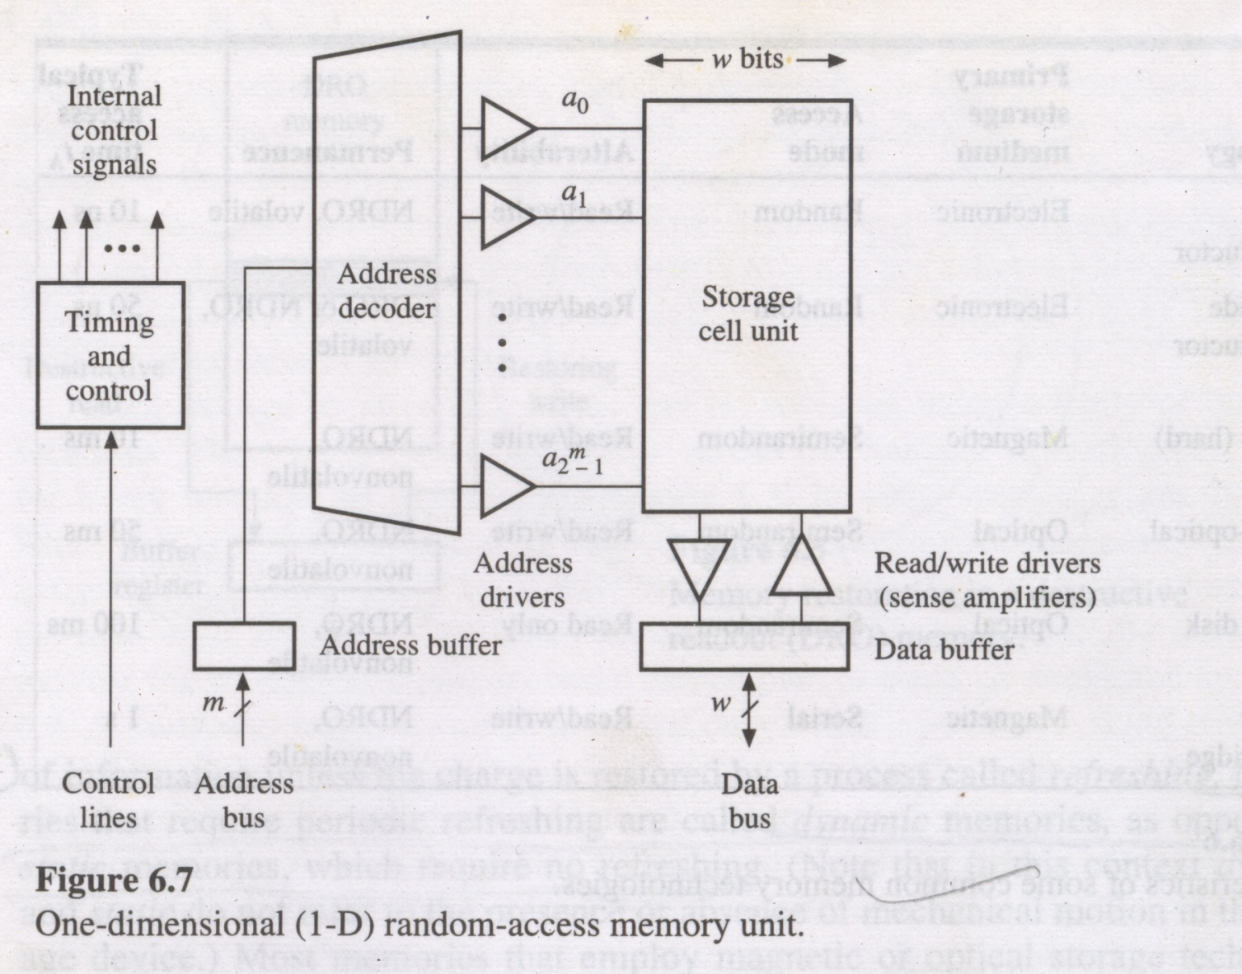
Random Access Memories

Slide 34
Random Access Memories
Working
Address from address bus is loaded into address buffer and passes to address decoder.
Address decoder activates the address location using address drivers for reading or writing the data. Type of access is specified by control line.
For read operation the contents of addressed location are transferred to data buffer and from there to data bus.
For write operation the contents of data buffer are written to addressed location.

Slide 35
Random Access Memories
Access Circuitry :
each cell is connected to set of data, address a control lines.
each line connected to storage cell is having a driver acting as amplifier/transducer of physical signal.
The drivers, decoders and control circuits form the access circuitry of RAM.

Slide 36
Multidimensional RAM
Storage cells are arranged in arrays to reduce the cost of the connection.
Memory address is partitioned into d components.

Slide 37
Memory allocation
Memory allocation:
It is the placement of blocks of information in a memory system.
Types:
Preemptive
NonPreemptive
Replacement policy:
method of selecting part of main memory to be used to keep the incoming block K of information.
Replacement policy assign K to M1 only when an unoccupied or inactive region of sufficient size is available.

Slide 38
Memory allocation
Good memory allocation strategy results in :
high hit ratio and low average access time
minimum amount of unused /underused space in M1.
Memory map for 2-level contains-
Occupied space list for M1
stores block name, address of the region and block size.
Available space list for M1
specifies address of an unoccupied region and its size
3. Directory for M2
specifies the unit that contain the directories for all the blocks associated with the current programs.

Slide 39
Memory allocation-Non-Preemptive
If no free space of sufficient size is available , region must be created for the incoming block of information.
Ex: block Ki of ni words is to be transferred to M1 from M2 and if none of the block can be preempted by Ki then available region of ni words must be created.

Slide 40
Memory allocation-Non-Preemptive
Algorithms(for segmented memory):
First fit
Best fit

Slide 41
Memory allocation-Non-Preemptive
First fit
It scans the memory map sequentially until an available region Rj of ni or more words is found.
ni : size of the incoming block Ki.
It then allocates Ki to Rj

Slide 42
Memory allocation-Non-Preemptive
Best fit
It scans the memory map completely and find a available region Rj of ni or more words such that nj - ni is minimized.
ni : size of the incoming block Ki.
It then allocates Ki to Rj

Slide 43
Memory allocation-Non-Preemptive
First fit
Example:
M1 stores 3 blocks as shown in table
and two new blocks K4(100) & K5(250) are
to be placed in M1
Region Address | Size(words)
0 | 50
300 | 400
800 | 200

Slide 44
Memory allocation-Non-Preemptive
First fit
0
0
Block K1
Block K1
300
Block K4
Block K5
650
Block K2
Block K2
800
800
Block K3
Block K3

Slide 45
Memory allocation-Non-Preemptive
Best fit
0
0
Block K1
Block K1
300
Block K5
550
Block K2
Block K2
800
Block K4
900
Block K3
Block K3

Slide 46
Memory allocation-Preemptive
In non preemptive memory allocation only partially filled memory may reject block transfer due to insufficient space.
Preemptive algorithm reallocate memory for making room for incoming blocks.
Reallocation is done in 2 ways:
blocks in M1 can be relocated within M1 to create gap for the incoming block.
blocks in M1 can be deallocated using a replacement policy.

Slide 47
Memory allocation-Preemptive
Relocation is done by compaction
Compaction:
blocks currently in main memory are compressed at the one end of the memory creating available region at the other side of memory.
Advantage :
simplicity
Drawback:
lengthy compaction time.

Slide 48
Memory allocation-Preemptive
Compaction: occupied region
available region
Block K1
Block K1
Block K2
Block K3
Block K2
Block K3

Slide 49
Memory allocation-Preemptive
Replacement policy:
criteria used for selecting block for de-allocation constitutes replacement policy.
Replacement policy goal:
maximizing the hit ratio.
Replacement policy:
Optimum Replacement
FIFO Replacement
LRU Replacement

Slide 50
Memory allocation-Preemptive optimum Replacement policy
Optimum replacement strategy at time ti determine the time tj>ti at which the next reference to block K is to occur.
Block K for which tj- ti has maximum value tk is replaced
It uses two pass execution
First pass (simulation run ) determine the sequence SB of the virtual block addresses generated by the program. (block address trace) optimal sequence SBOPT is constructed from SB
Second pass(execution run ) uses SB OPT to specify the blocks to be replaced

Slide 51
Memory allocation-Preemptive optimum Replacement policy
It is not a practical implementation policy due to :
Cost of simulation run
SB can be a very long sequence which causes calculation of SB OPT very expensive.

Slide 52
Memory allocation-Preemptive FIFO Replacement policy
Selects block for replacement which is least recently loaded into M1
Implementation:
sequence number is assigned to each block at its load time.
sequence number is updated every time it is transferred to or from M1.
MMU check sequence numbers and select a block with lowest sequence number for replacement.
Drawback:
Frequently used blocks are replaced only because it is oldest one.

Slide 53
Memory allocation-Preemptive LRU Replacement policy
Selects block for replacement which is least recently accessed by the processor.
Implementation:
Hardware /software counter called an age register is associated with each block in M1.
When block is referred by CPU age is set to some predetermined positive number.
At fixed interval of time, age register is decremented by fixed amount.
Block with smallest age value is LRU block to be replaced.

Slide 54
Replacement Algorithms
CPU Reference
A
B
C
A
D
E
A
D
C
F
Miss
Miss
Miss
Hit
Miss
Miss
Miss
Hit
Hit
Miss
Cache
FIFO ➔
A
A
A
A
A
E
E
E
E
E
B
B
B
B
B
A
A
A
A
C
C
C
C
C
C
C
F
D
D
D
D
D
D
Hit Ratio = 3 / 10 = 0.3

Slide 55
Replacement Algorithms
CPU Reference
A
B
C
A
D
E
A
D
C
F
Miss
Miss
Miss
Hit
Miss
Miss
Hit
Hit
Hit
Miss
Cache
LRU ➔
A
B
C
A
D
E
A
D
C
F
A
B
C
A
D
E
A
D
C
A
B
C
A
D
E
A
D
B
C
C
C
E
A
Hit Ratio = 4 / 10 = 0.4

Slide 56
Replacement Algorithms
CPU Reference
A
B
C
A
D
E
A
D
C
F
Miss
Miss
Miss
Hit
Miss
Miss
Hit
Hit
Hit
Miss
Cache
OPT➔
A
B
C
A
D
E
A
D
C
F
A
B
C
A
D
E
A
D
C
A
B
C
A
D
E
A
D
B
C
C
C
E
A
Hit Ratio = 4 / 10 = 0.4

